Slide 1


Presented By: Rashmi R
Supraja S

Slide 2
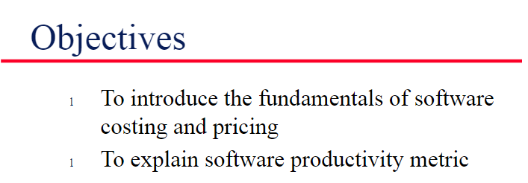
The goals that guide your business in setting the cost of a product or service to your existing or potential consumers.
Some examples of pricing objectives include maximizing profits, increasing sales volume, matching competitors' prices, deterring competitors – or just pure survival.

Slide 3

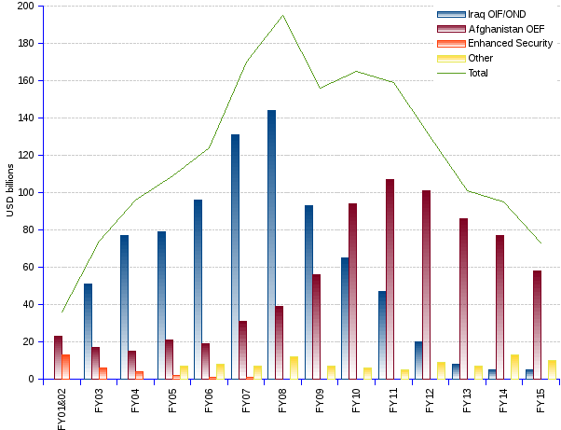
Software Pricing
The price of a software product to a customer is simply the cost of development plus profit for the developer.
Estimates are made to discover the cost, to the developer, of producing a software system.
There is no simple relationship between the development cost and the price charged to the customer.
Broader organizational, economic, political and business considerations influence the price charged.

Slide 4
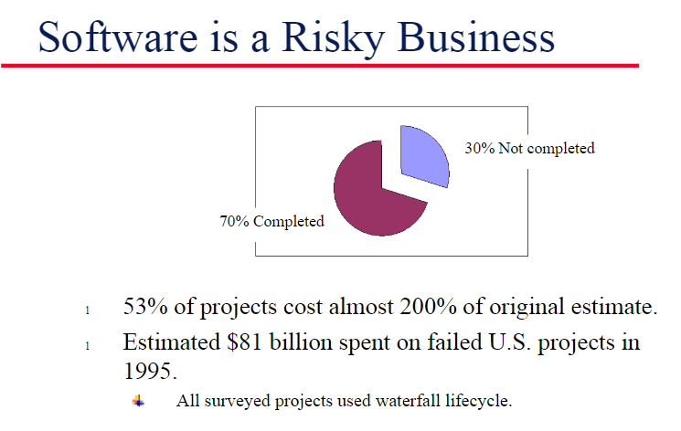

Slide 5
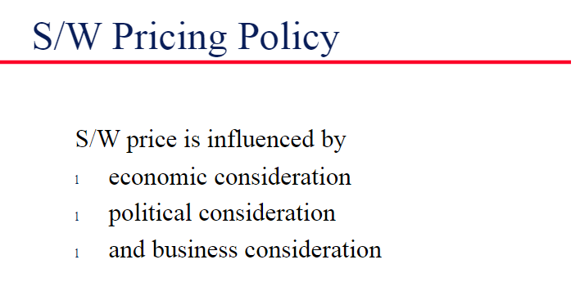




Slide 6
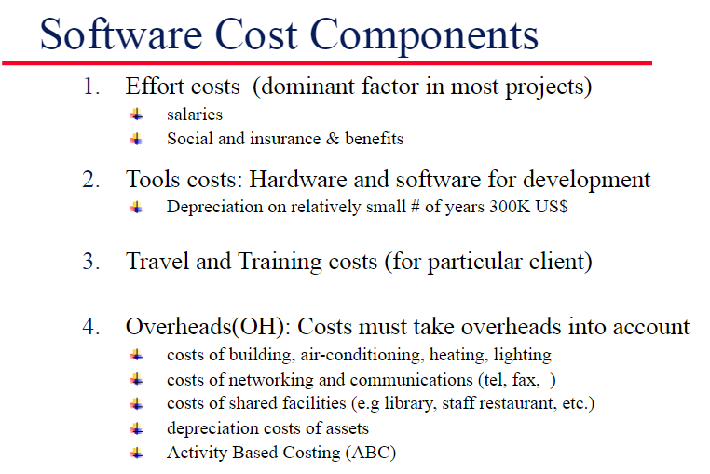

Slide 7
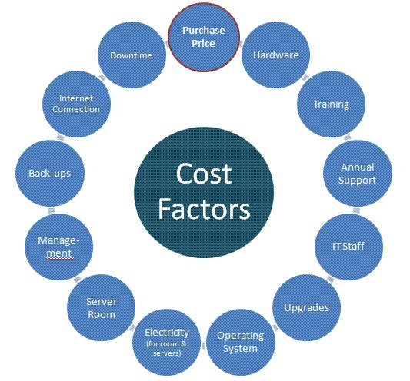

Slide 8
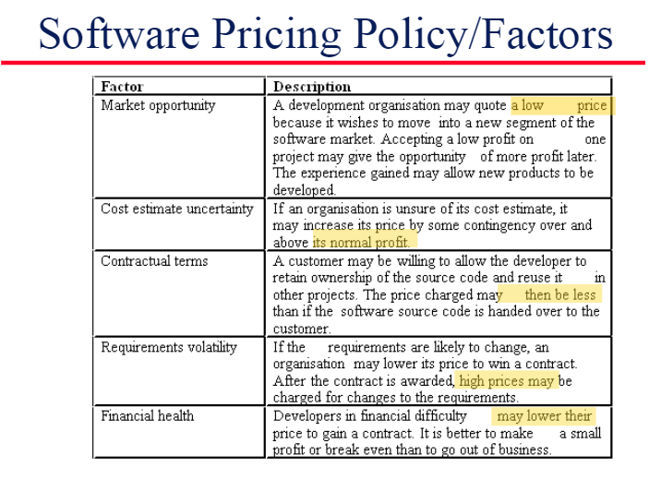

Slide 9

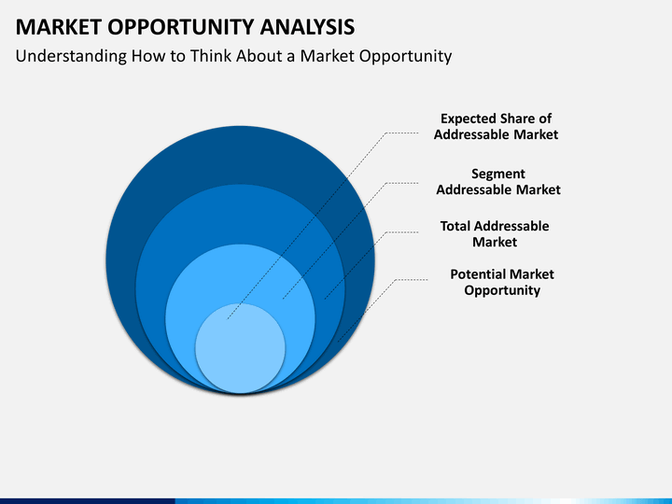


Market Oppurtunity
A development organization may quote a low price because it wishes to move into new segment of software market.
The experience gained may allow new products to be developed.

Slide 10
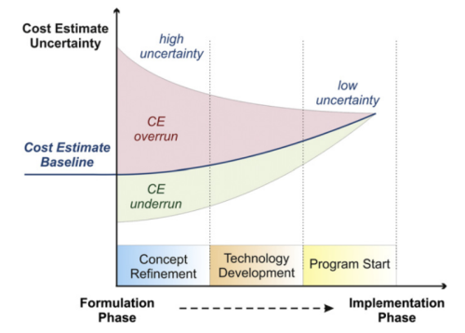
Cost Estimate Uncertainity
If an organization is unsure of its cost estimate it may increase price by contingency over and above its normal profit.

Slide 11


Contractual terms
A customer may be willing to allow the developer to retain the ownership of the source code and use it in other projects.
The price charged may then be less than if the software source code is handed over to the customer.

Slide 12
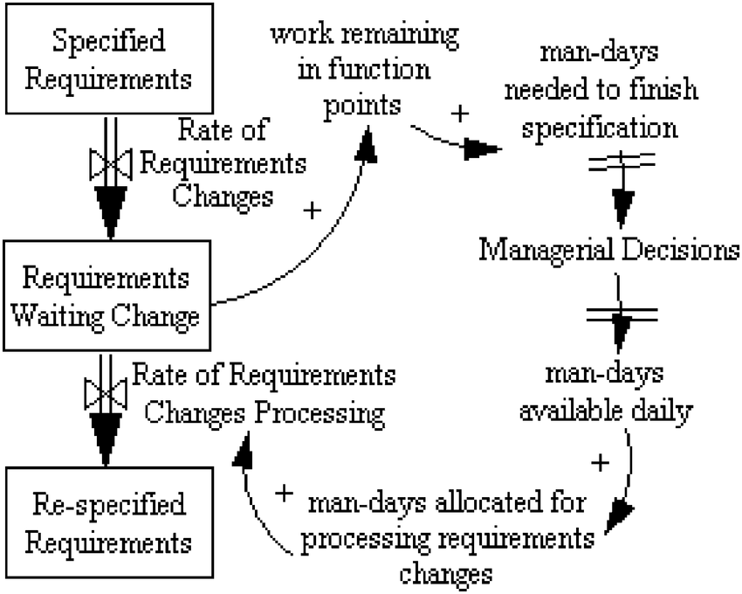
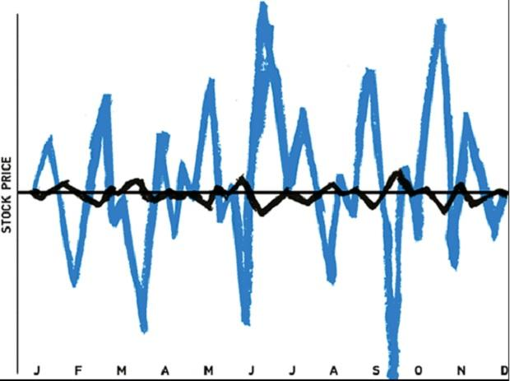
Requirements Volatiity
If the requirements are likely to change, an organization may lower its price to win a contract.
After the contract is awarded, high prices may be charged to the changes in the requirements.

Slide 13


Financial Health
Developers in financial difficulty may lower their price to gain a contract.
It is better to make a small profit or break-even than go out of business.

Slide 14
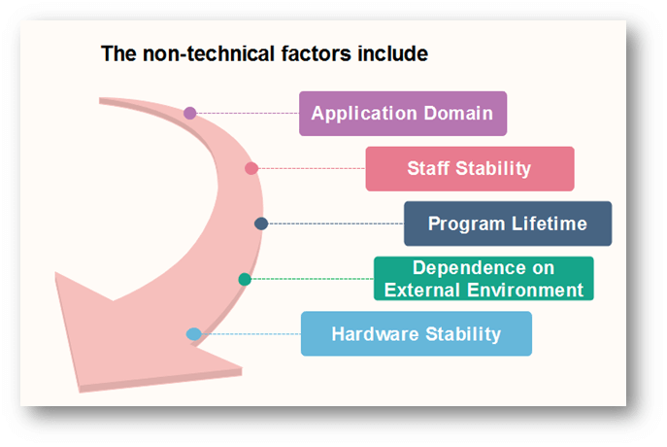

Slide 15
Conclusion
Having a price strategy is a very healthy action to take for business of all sizes.
Hence , an organization in the software market establishes its stability by the effective use of software pricing technique.
The significance of software cost estimation is hopefully delivered in an appropriate manner to the viewers of this presentation.

Slide 16
Bibliography
Google web
Google images
Wikipedia
LinkedIn
Others……….

Slide 17
THANK YOU

